Slide 1

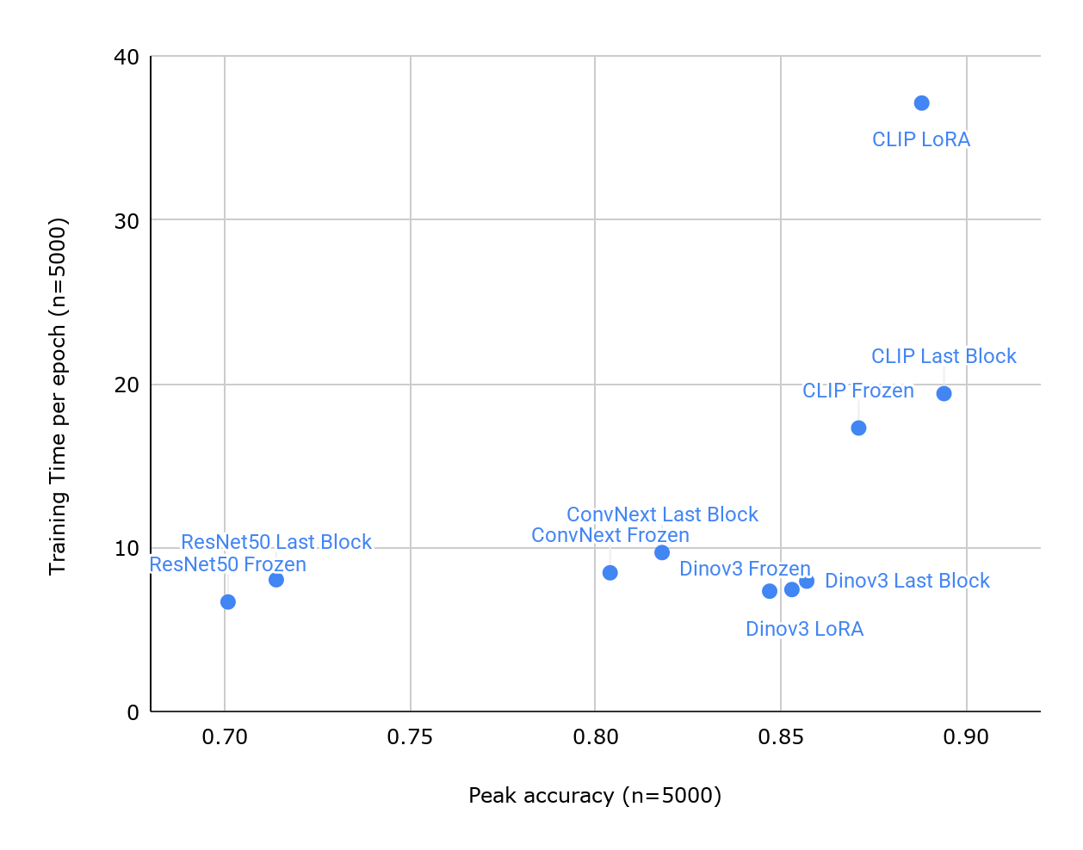
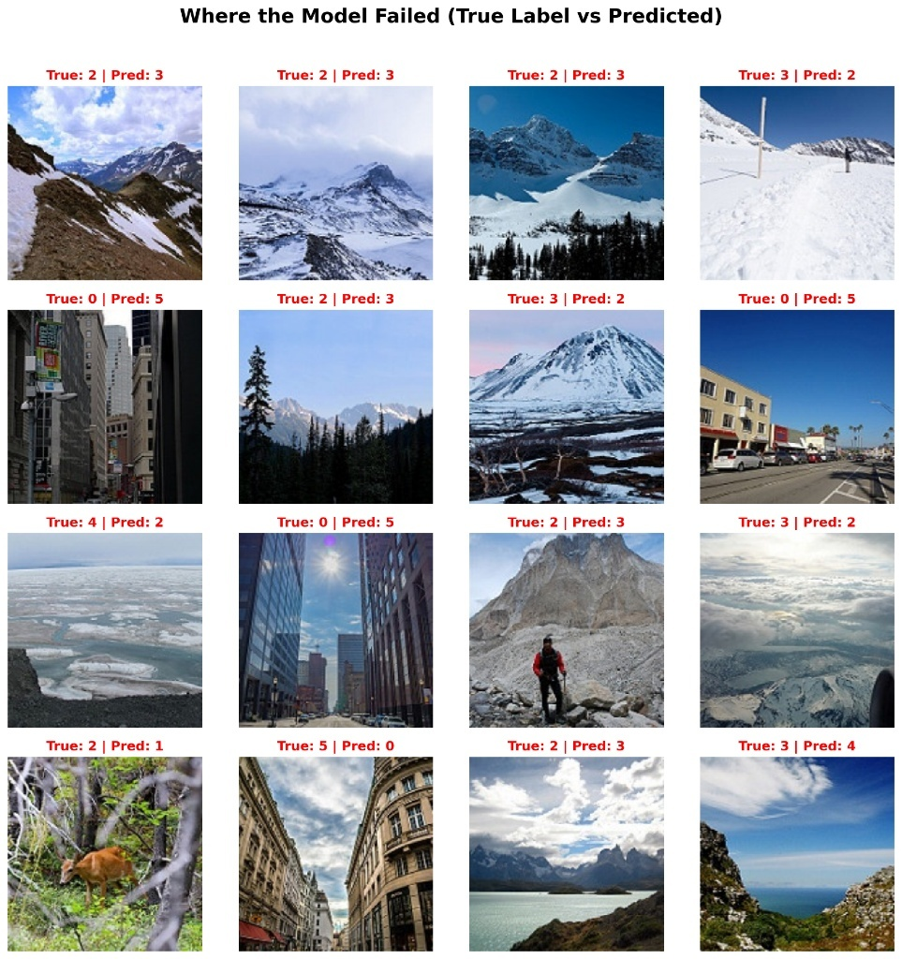

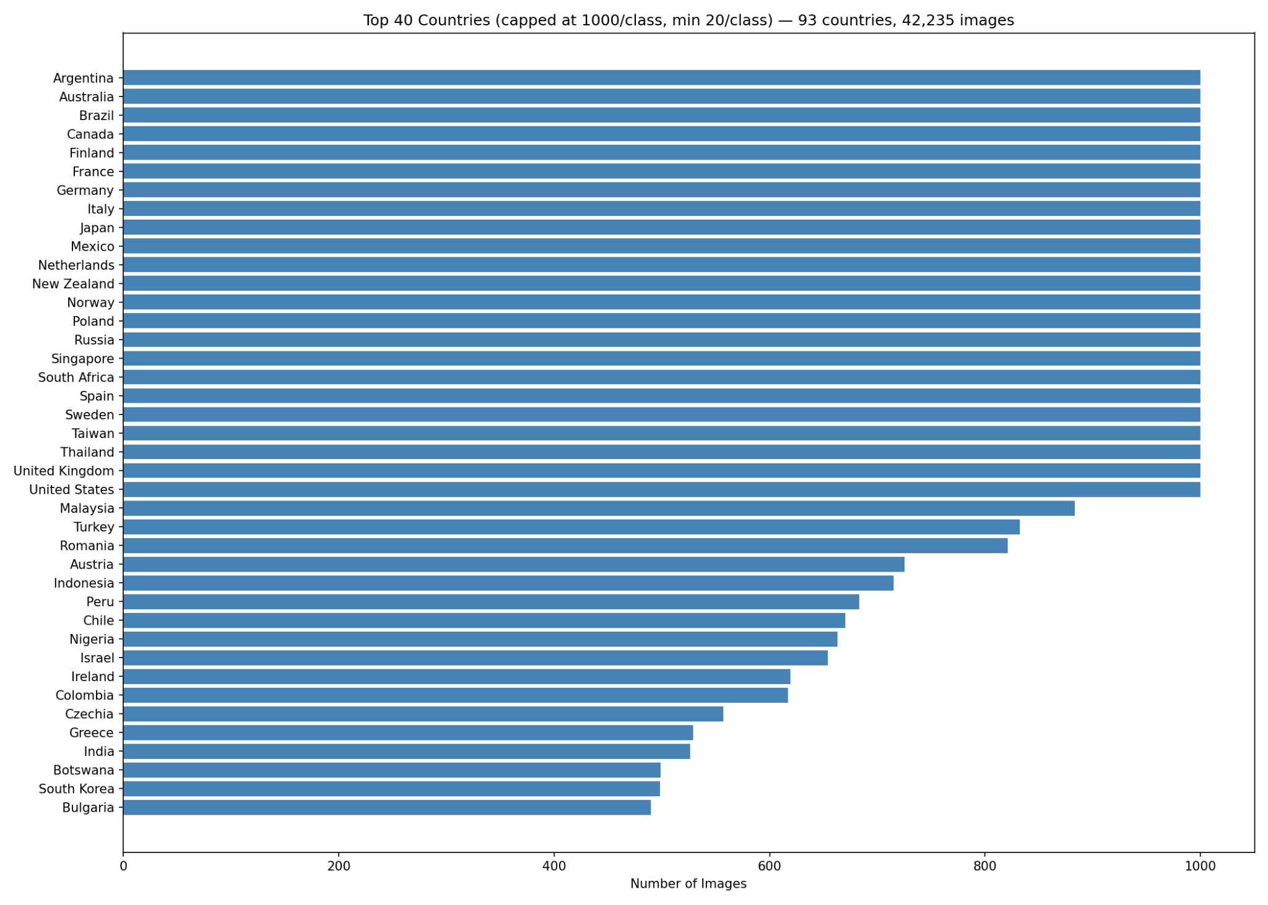
Where in the World? Geolocation Classification
Madeleine Poissonnier Sam Weiss Dylan Ellis Luis Ocampo
CSCI 1430
Where in the World? Geolocation Classification
Motivation & Goal
Geolocation prediction requires learning of subtle environmental, architectural, and geographic cues to accurately infer where a photo was taken. This process when done by humans, takes years of accumulated knowledge. Inspired by GeoGuessr, our project explores the use of Transformers to classify images across three levels: biome, settlement, and country.
United States of America
Data & Preprocessing
Figure 2. Accuracy vs. Training Time by Architecture & Fine-Tuning Strategy
Task | Dataset | Labels | Images
Biome | Intel Image Classification | Buildings, Forest, Glacier,Mountain, Sea, Street | ~25,000
Settlement | Global Streetscapes | Urban, Suburban, Rural | ~20,000
Country | Geoguessr | 93 countries represented | ~50,000
Model Architecture
Baseline Continent Classifier Architecture
Based on the results from the the 10 training loops we used the CLIP + LoRA pipeline as our country classification baseline. We implemented a uniform pipeline across all subsequent models.
Biome Classifier Architecture
Biome classification employs a six-way classification head mapping images to one of the defined biome categories. To easily combine with the other models, the classifier head can easily be dropped so that the 768-dimensional visual embeddings can be extracted.
Urban v Suburban v Rural Architecture
Settlement type employs a three-way classification head distinguishing the three defined settlements. As with the biome model, the classifier head can be dropped to extract raw 768-dimensional embeddings for use in the final classifier.
Continent Classifier Acrhitecture with Embeddings
The the previous models’ embeddings were concatenated into a 2304-dim vector which we added to our this model before hitting the final classification head.
Figure 3. Model Failure Cases (True Label vs. Predicted)
Settlement classification achieved the highest accuracy since classification relies on visual cues like density of infrastructure, vegetation coverage, and building spacing. Biome classification was the second highest since biome boundaries are also strongly visually distinct. Country classification achieved the lowest accuracy due to the visual similarity between many regions. After concatenating the three embeddings we saw no real change in accuracy. We attribute this lack of improvement to the fact that the country features likely already implicitly encode much of the environment and settlement context that we anticipated the additional embeddings contributing.
For each dataset, all labels were normalized and images were resized to a uniform 224×224.
Challenges, Reflection, and Acknowledgements
Of the 196 countries in the world, only ~140 were represented leading to a data imbalance across countries. Additionally, combining the embeddings from the three classifiers did not yield the improvement that we expected. We are still experimenting with finetuing methods to improve accuracy. Overall, this project deepened our understanding of how geographic context can be extracted from visual data, and highlighted both the success and the limitations of computer vision models for geolocation tasks. Thank you to Kelvin for his help and guidance with this project!
Results
Figure 1. Top 40 Countries (max 1000/class, min20/class) - 93 countries, 42,235 images
Training Loops
We evaluated 10 training loops across 4 architectures, DINOv2, ResNet50, CLIP, and ConvNeXt, with various fine-tuning strategies on the GeoGuessr dataset. Results are shown in Figure 2.
Classification Type | Accuracy
Continent Classification | 87.9%
Biome Classification | 94%
Settlement Classification | 97%
Continent Classification + Embeddings | 88.9%

